Slide 2
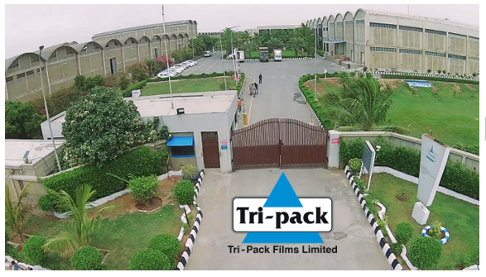
CORPORATE
BRIEFING
SESSION
APRIL 2026

Slide 3
Operational Overview
BOPP
Location | No. of Lines | * Total Name Plate capacity (p.a. tons) | ** Total Operational Saleable capacity (p.a. tons)
Hattar | 2 lines 4.2m Mitsubishi each | 10,800 | Machines are obsolete with no technical support from OEM, as a result their capacity to produce quality films is nil.
Port Qasim | 3 lines 6.7m Mitsubishi 8.7m Brueckner 10.4m Brueckner | 111,000 | 78,000
Total | 5 lines | 121,800 | 78,000
*Nameplate Capacity: 25 micron film produced 24/7 without downtime.
**Saleable Capacity:
Based on actual
Product mix. Microns ranging from 10-40.
CPP
Port Qasim | 2 lines 3m & 3.3m Windmöller | 17,000 | 14,400
Metallizers
Port Qasim | 5 Metallizers BOBST | 43,200 | 32,600 (One of the Metalizer is not operational being obsolete)
Recycling
Port Qasim | 3 machines Erema | 18,200 | 18,200
BOPP Tape
Port Qasim | ***Adhesive Tape Machine (To be commissioned in 2026) | 6,600 | 5,400

Slide 4
Domestic Market (ktons) – Competitive Landscape & Demand / Supply
Market growth assumed at 7%p.a.
Market growth assumed at 3% p.a.
Notes:
Updated,

Slide 5
Major Performance Highlights – 2025 Vs 2024 (SPLY)
No lost time injury occurred in 2025.
Domestic and export volumes were higher than SPLY by +4% each.
  Gross margins increased by +1.5 ppts vs SPLY owing to higher sales in domestic market.
  For 2025:
  Operating profit (EBIT) at Rs 2,090 million (+6% vs SPLY).
  Loss before tax at Rs 235 million (+19% vs SPLY).
  Loss after tax at Rs 367 million (+15% vs SPLY).
Effective tax
%
-56 vs -49
15% increase
Inflation
%
3.5 vs 13.1
73% decrease
Homo ICIS
$/ton (Rs/kg with duties)
937(276) vs 1,045 (309)
10% decrease
Gas tariff
Rs/mmbtu
NG: 4,071 vs 2,833
RLNG: 3,756 vs 3,765
44% increase in NG
Notes:
MARKET SHARE PPTS
ICIS with or without duty

Slide 6
Major Performance Highlights – Q1 2026 Vs Q1 2025 (SPLY)
No lost time injury occurred in 2026.
Domestic and export volumes were higher than SPLY by +7% and +21% respectively.
Gross margins increased to 17.2% vs 13.5% in SPLY owing to improved pricing, higher volumes & improved efficiencies.
  For 2026:
  Operating profit (EBIT) at Rs 863 million (+61% vs SPLY).
  Profit before tax at Rs 302 million (+428% vs SPLY).
  Profit after tax of Rs 41 million vs loss of Rs 21m in SPLY (+295% vs SPLY)
Effective tax
%
87 vs -77
212% increase
Inflation
%
7.3 vs 1.5
387% increase
Homo ICIS
$/ton (Rs/kg with duties)
1,024(301) vs 1,003(299)
Current: 1,650 (489)
2% increase
Gas tariff
Rs/mmbtu
NG: 4,599 vs 3,839
RLNG: 4,176 vs 3,663
Current NG: 4,906
Current RLNG: 4,890
20% increase in NG
Notes:
Local volume were +4 no polypack impact in feb & march & plain 30 market growth(5star)
Export -19% no RM & prioritized local

Slide 7
Profit & Loss – YTD

Slide 8
Financial Highlights

Slide 9
Statement of Financial Position – As At
We have recovered Rs.1.6 billion sales tax since 2024.
Reduction in total debt by Rs. 2 billion since 2024.

Slide 10
Cashflow Statement for the Period

Slide 11
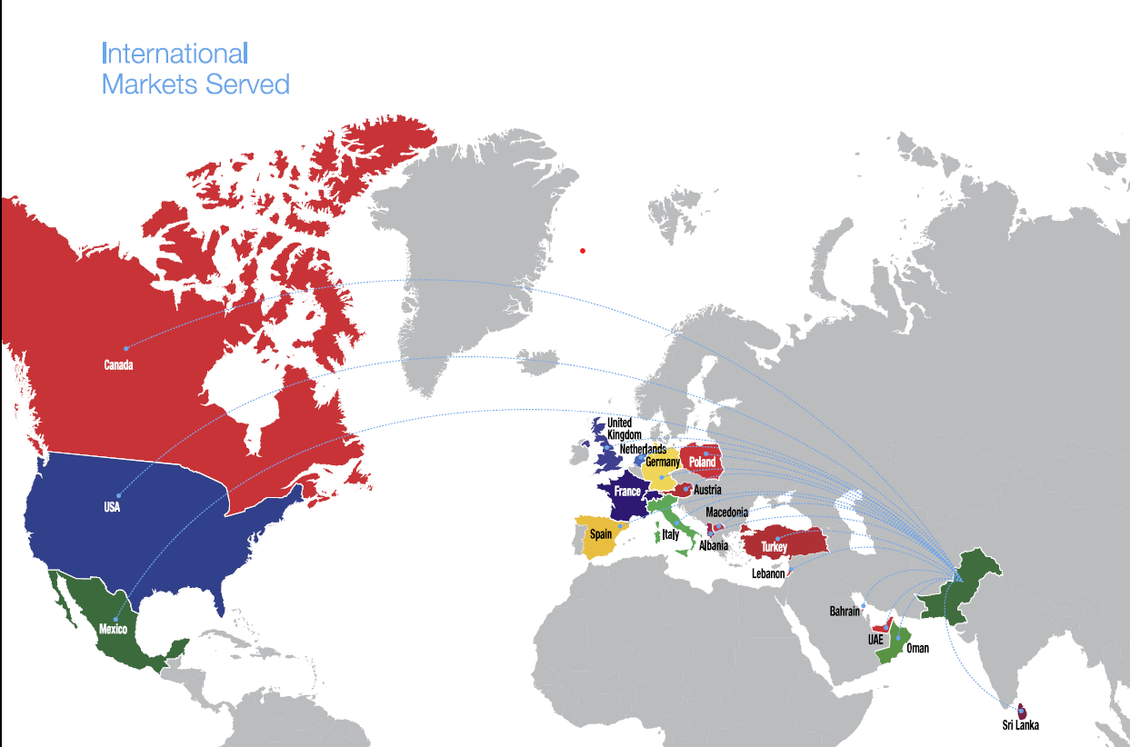
Export Market
Export volumes grew by 4%.
We expanded our footprint in Europe and North America while adding 11 new customers in that region.
Approximately 17% of capacity is going into exports.

Slide 12
FUTURE OUTLOOK

Slide 13
Future Outlook
Supply overhang for BOPP and CPP will continue.
Ongoing regional situation is impacting supplies and sales volume.
Potential increase in interest rates and inflation along with FX risks will negatively impact going forward.
Gas supply and prices may become a challenge owing to RLNG shortfalls in the system. However, we are in the phase of implementing Battery Energy Storage System (BESS) which will enable smooth use of economical Grid Power.
We are determined to improve sales proportion from value added films in domestic & export markets. This will not only improve our capacity utilization but will also increase our product offerings and resultantly margins.
Despite above mentioned challenges, we are confident that with continued focus on operational efficiencies, effective working capital management and cost reduction initiatives, we shall be able to secure better margins and improve profitability.

Slide 14
Important Disclaimer
This presentation has been prepared by Tri-Pack Films Limited (TPFL) solely for information purposes. No representation or warranty express or implied is made there to, and no reliance should be placed on, the sufficiency, completeness or relevance of the information or any opinion contained herein, or any opinion rendered thereto. The information contained in this presentation should be considered in the context of the circumstances prevailing at the time and will not be updated to reflect any developments that may occur after the date of the presentation. TPFL shall not have any responsibility and / or liability of any nature whatsoever (in contract or otherwise) for any loss whatsoever arising from any use of this presentation or its contents or otherwise arising in connection with this presentation.
This presentation does not constitute or form part of a prospectus, offering circular or offering memorandum or an offer, solicitation, invitation or recommendation to purchase or subscribe for any securities and no part of it shall form the basis of, or be relied upon in connection with, or act as any inducement to enter into any arrangement, agreement, contract, commitment or investment decision in relation to any securities. This presentation shall not at all be intended to provide any disclosure upon which an investment decision could be made. No money, securities or other consideration is being solicited, and, if sent in response to this presentation or the information contained herein, will not be accepted.
Certain data in this presentation was obtained from various external data sources that TPFL believes to its knowledge, information and belief to be reliable, but TPFL has not verified such data with independent sources and there can be no assurance, representation or warranty as to the accuracy, sufficiency, correctness or completeness of the included data. Accordingly, TPFL makes no assurance, representation or warranty as to the accuracy, sufficiency, correctness or completeness of that data, and such data involves risks and uncertainties and is subject to change based on various factors.
By attending this presentation, you are agreeing to be bound by the foregoing limitations.

Slide 15
QUESTION AND ANSWERS

